Slide 1
6.6 Series Resonance (串聯諧振)
The resonant circuit behaves as a bandpass filter (帶通濾波器)。
A band of components centered at the resonant frequency is passed (在共振頻率附近的頻帶會通過)。
The components farther from the resonant frequency are rejected/reduced .

Slide 2
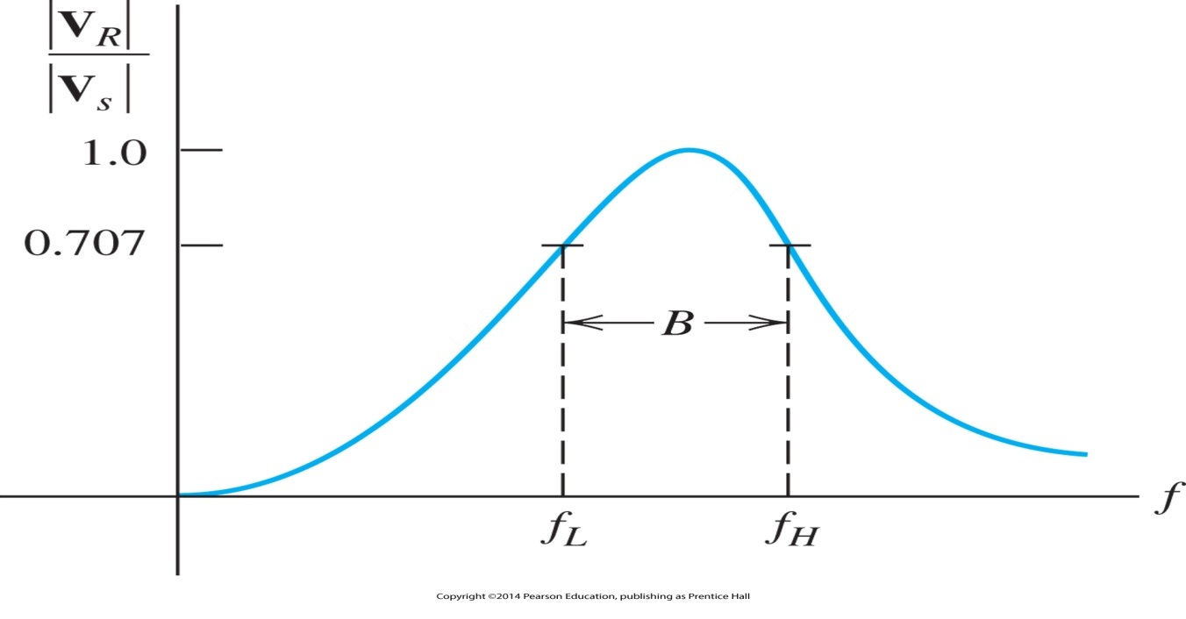
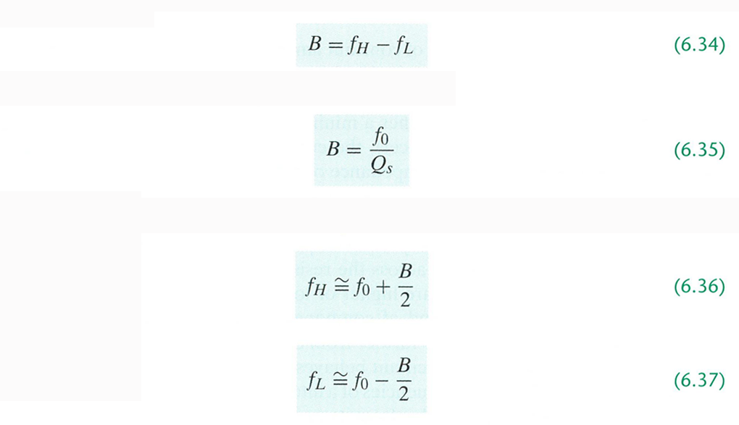
f₀
Bandwidth (頻寬): B
f₀ :fundamental frequency
Q: quality factor (品質因子)
Q_{s} 越大通過的頻寬越窄(B越小)，越具選擇性，品質越好
f_{H} , f_{L} 代表高低兩個 half-power frequency

Slide 3
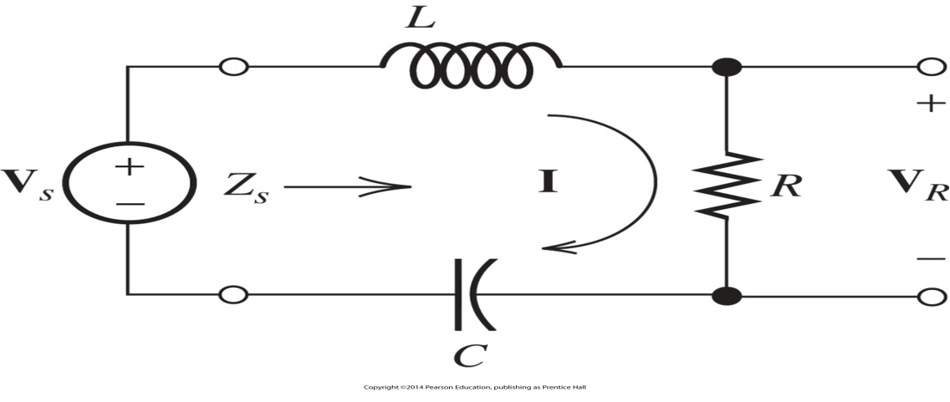
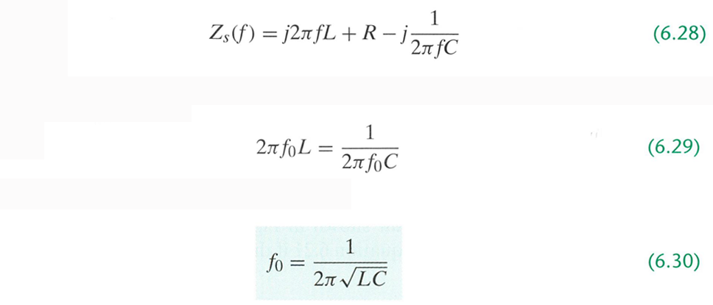
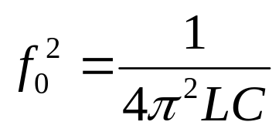
The series resonant circuit
整體阻抗
在共振頻率出現時，電容與電感的阻抗magnitude 相同，整體阻抗只剩電阻，電阻電壓最大 (輸出最大)

Slide 4


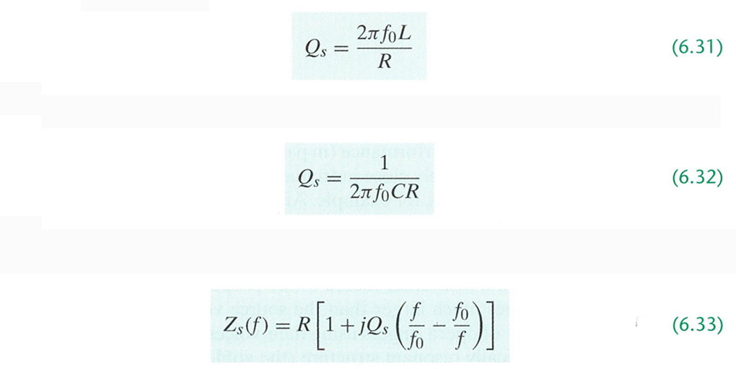
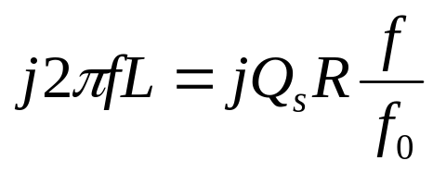
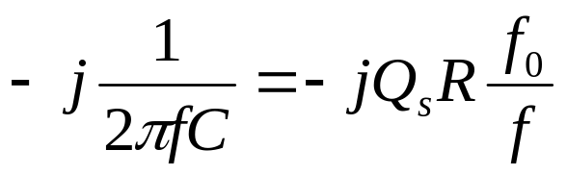
For a series circuit, the quality factor (品質因子)
is defined as
(電感電抗與電阻的比值)
因為 ,, 所以Q_{s}也可表示成

Slide 5
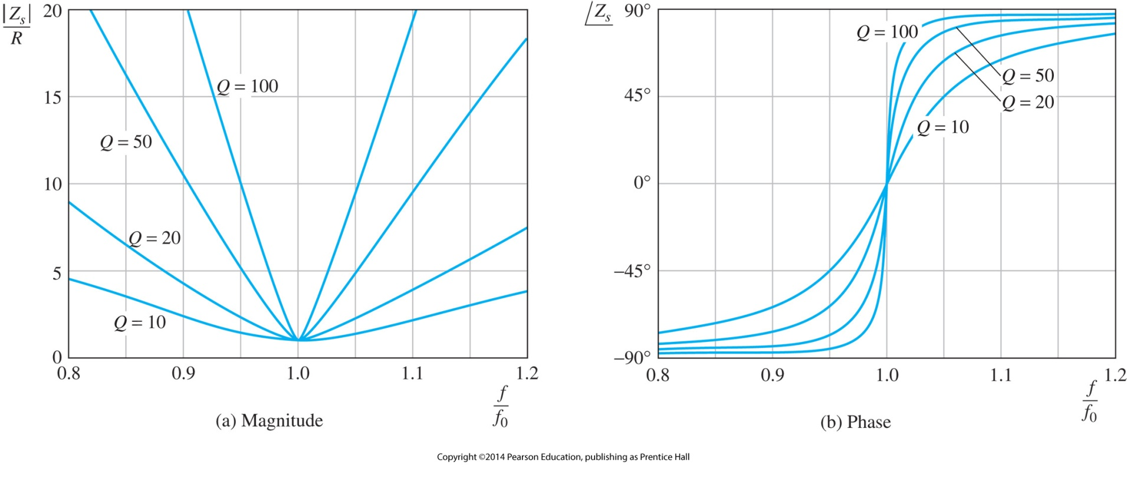
整體阻抗 可改寫為

Slide 6
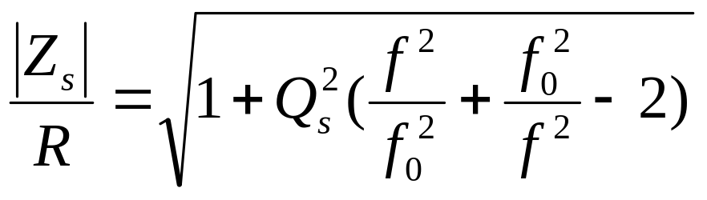
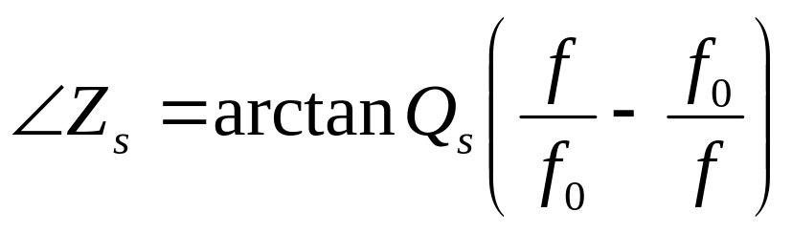
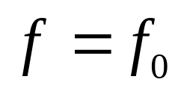
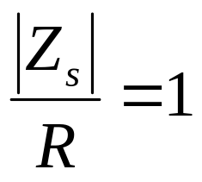
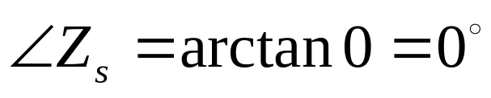
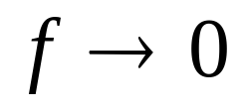
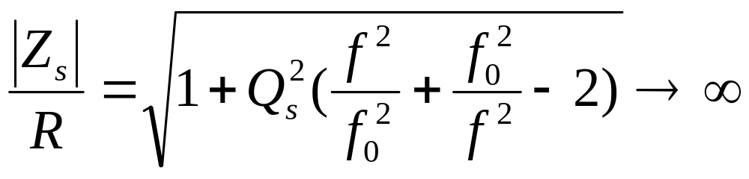
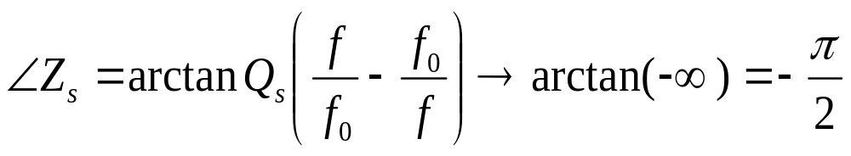
1. For
2. For low frequency

Slide 7
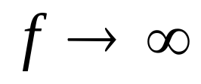
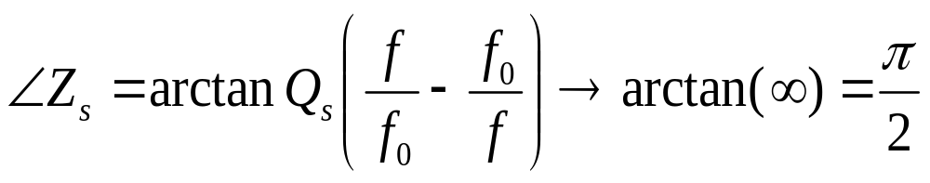
3. For high frequency
Impedance magnitude 在 最小，而 越大
斜率越大。

Slide 8
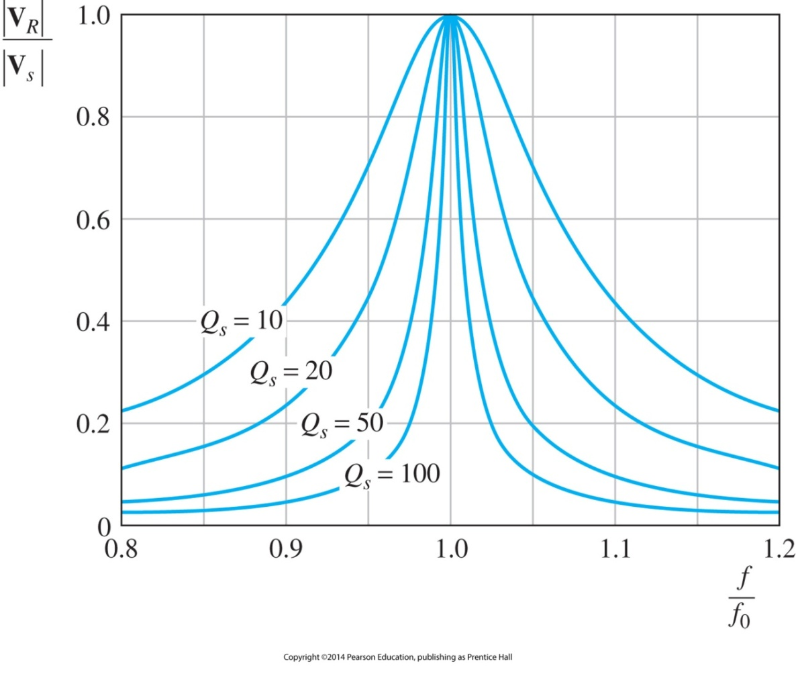
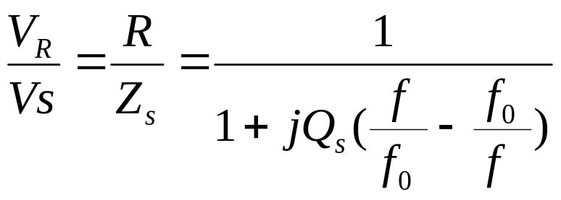
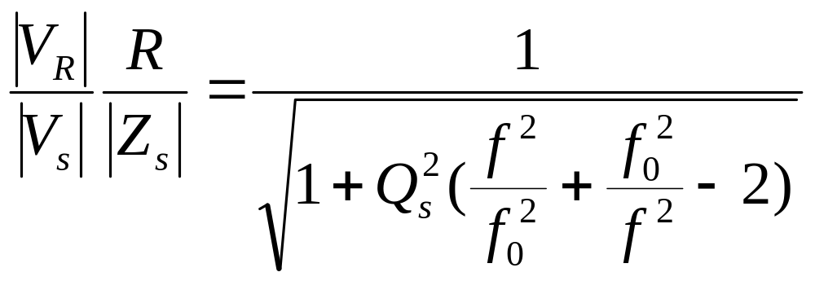

Slide 9
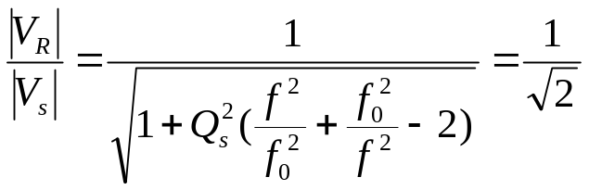
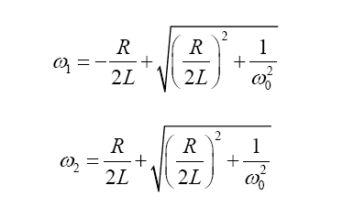
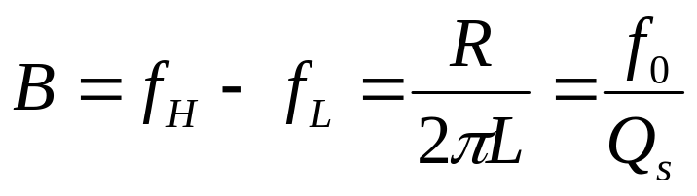
f₀
Bandwidth (頻寬):
When Q_{s} >>1, are given by the approximate expressions
f_{H} , f_{L}

Slide 10
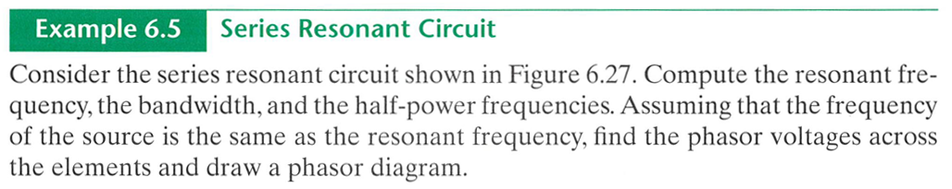
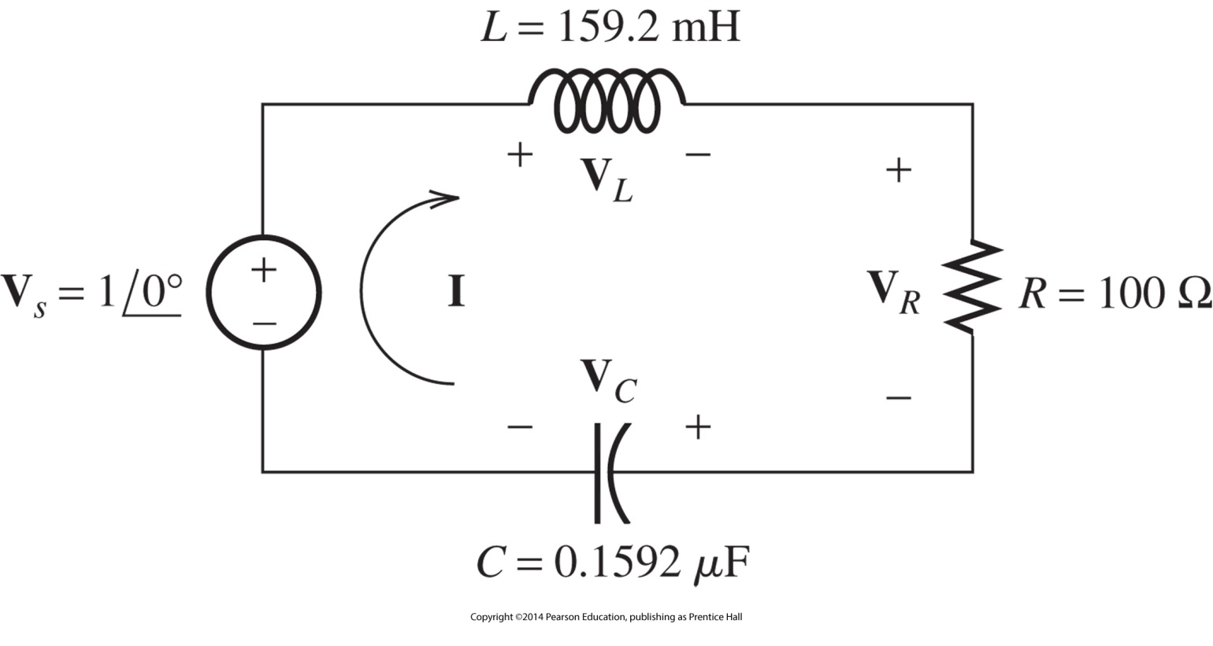

Slide 11
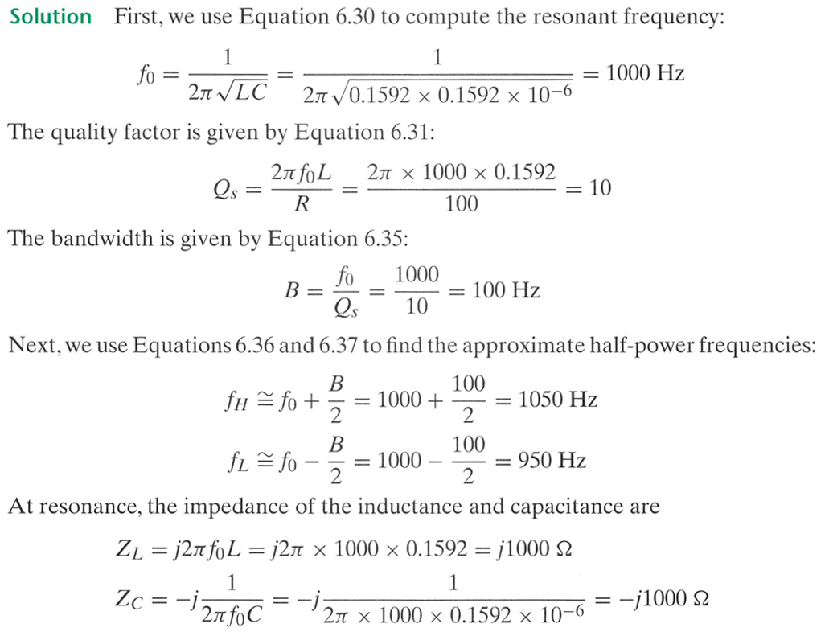

Slide 12
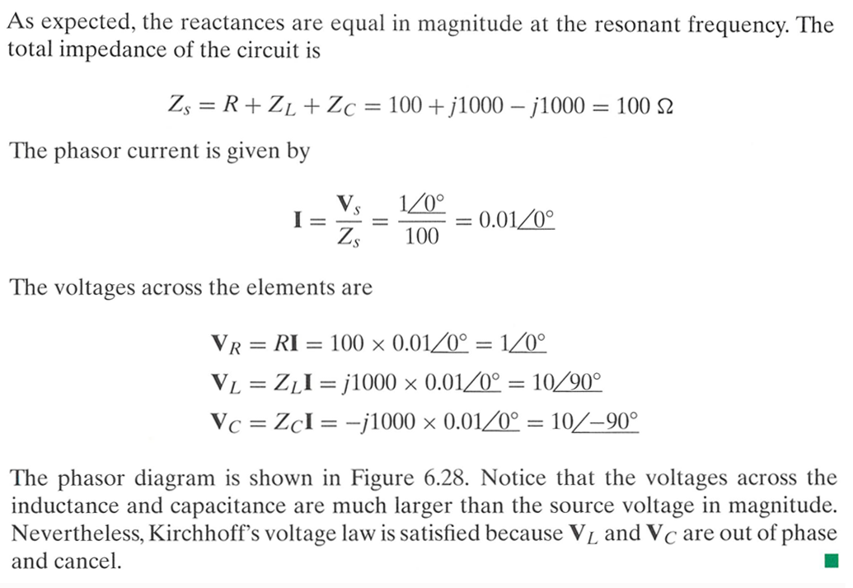
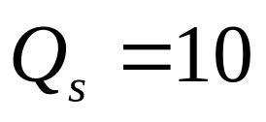

Slide 13
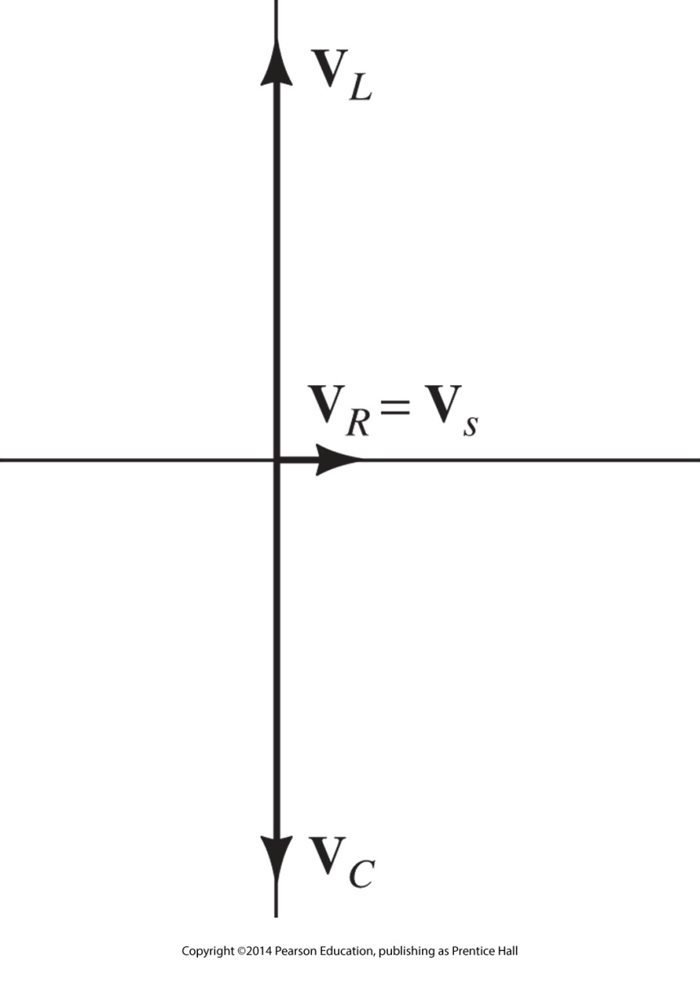
Phasor Diagram

Slide 14
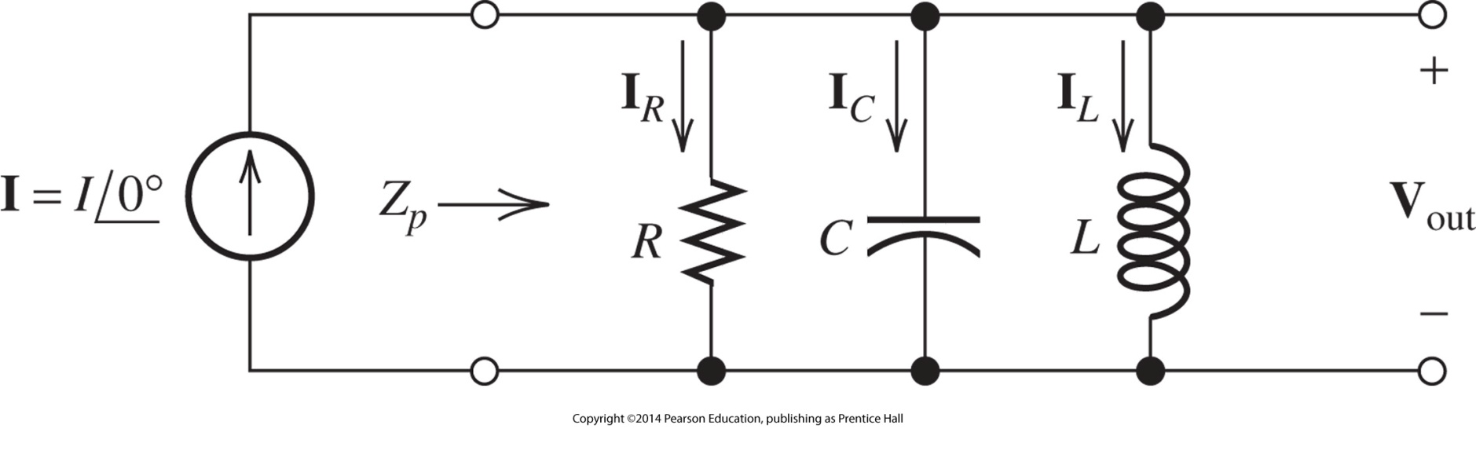

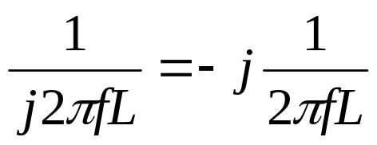
6.7 Parallel Resonance
整體阻抗
在共振頻率出現時，電容與電感的阻抗magnitude 相同，整體阻抗只剩電阻

Slide 15

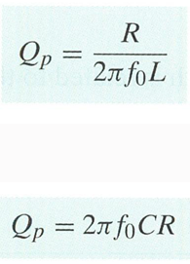
For a parallel circuit, the quality factor
is defined as
(與series circuit 相反)
亦可表示成

Slide 16
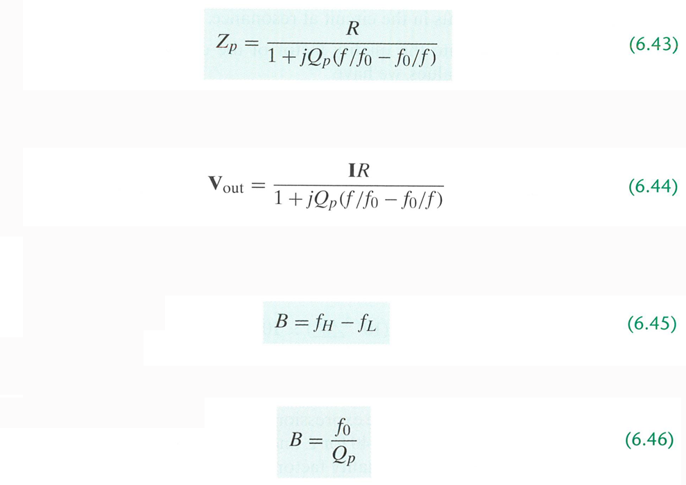
整體阻抗
可改寫為
輸出 phasor voltage

Slide 17
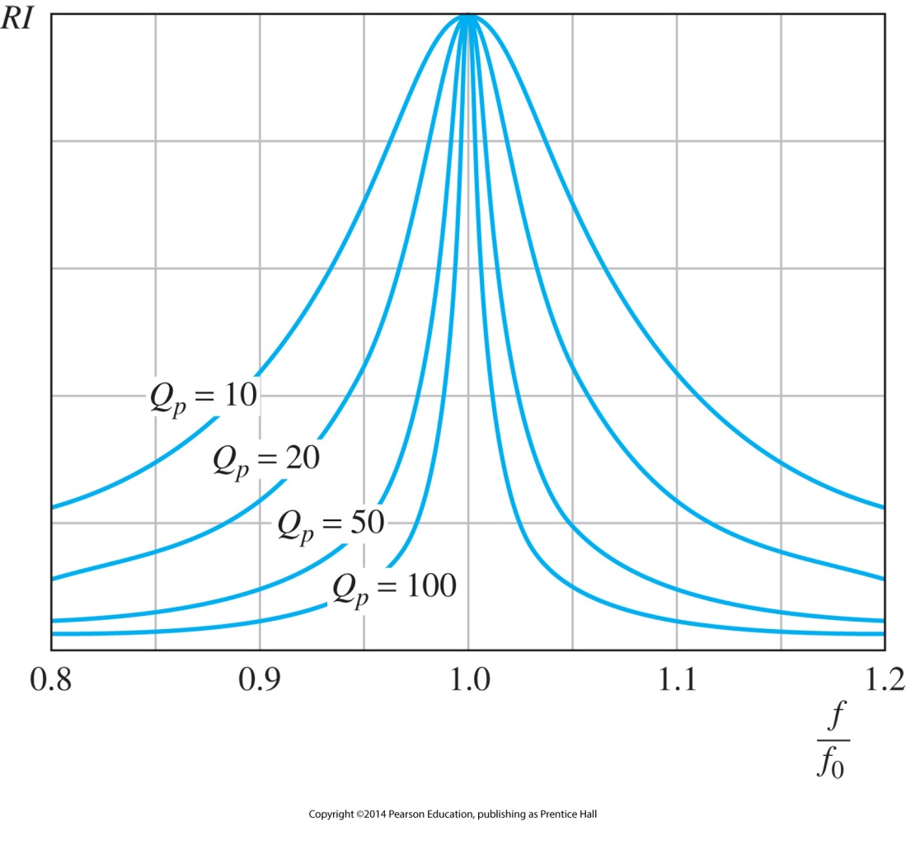
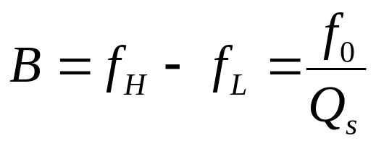
Bandwidth (頻寬):

Slide 18
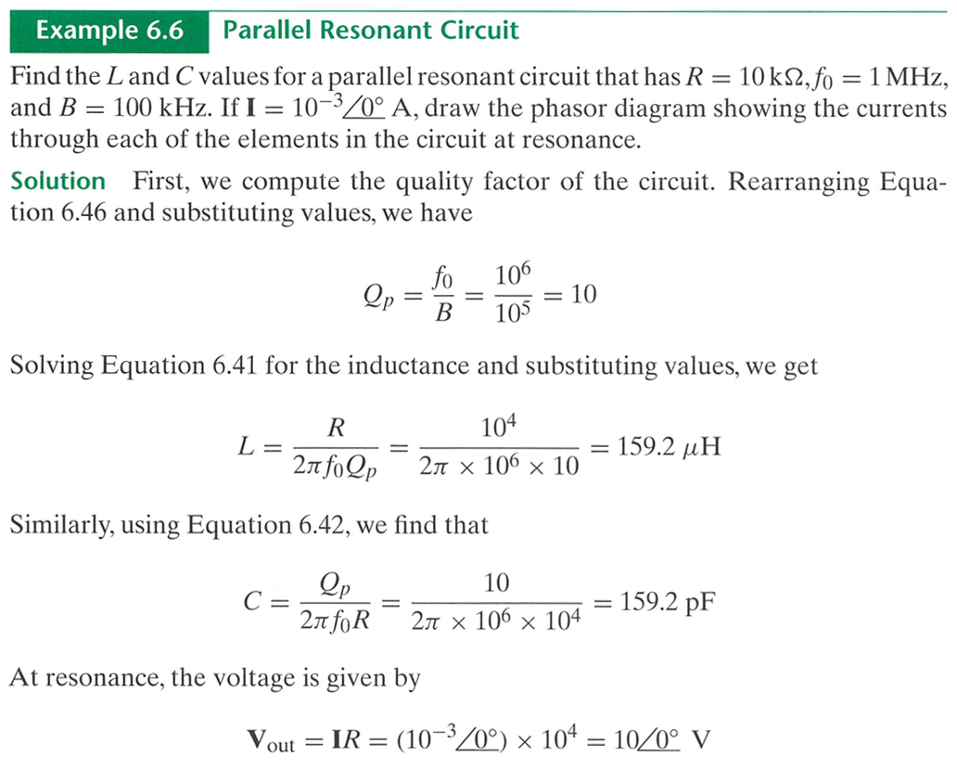
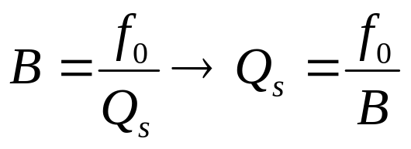
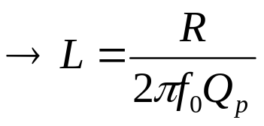
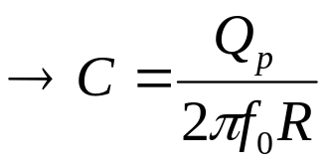

Slide 20
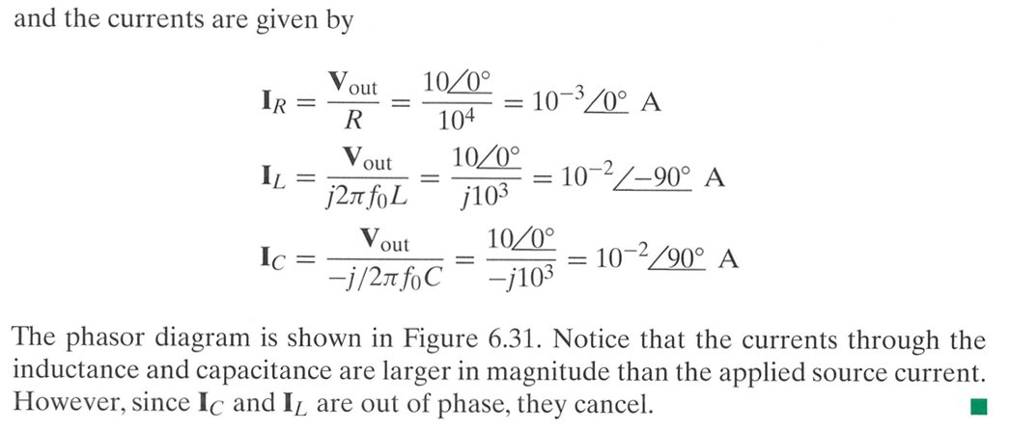

Slide 21
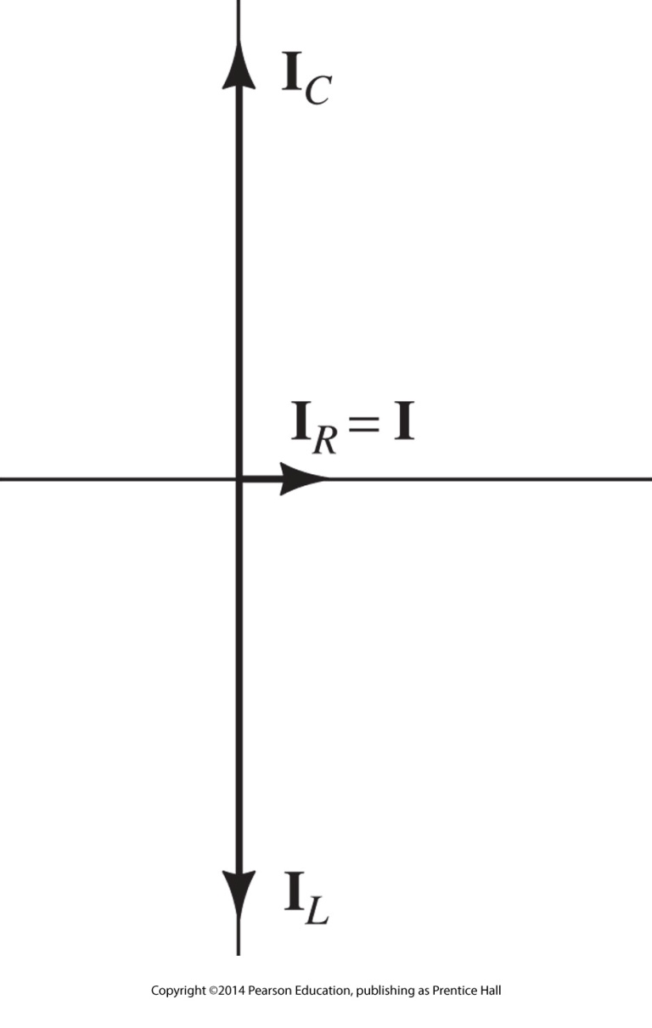
Phasor diagram

Slide 22

Resonance in a mechanical system
Tacoma Narrow Bridge
http://www.youtube.com/watch?v=j-zczJXSxnw

